Slide 1
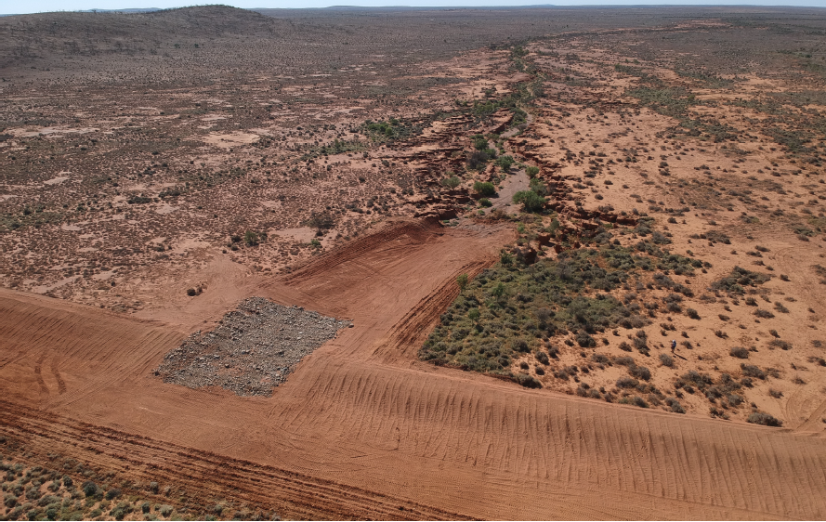
Flow direction
Upstream
migration of
gully head
Rocks reduce
flow rate
Checkbank
Excess flows
Spread over
wide area
Checkbank

Slide 2
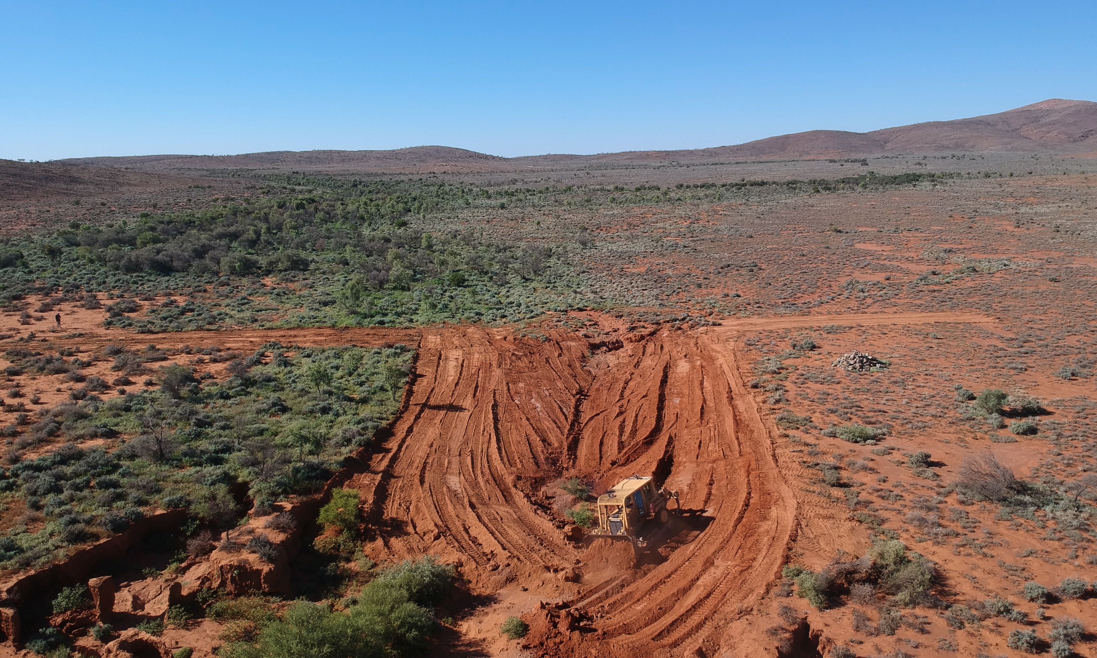
Direction of
water course
Head of
erosion gully

